Slide 1
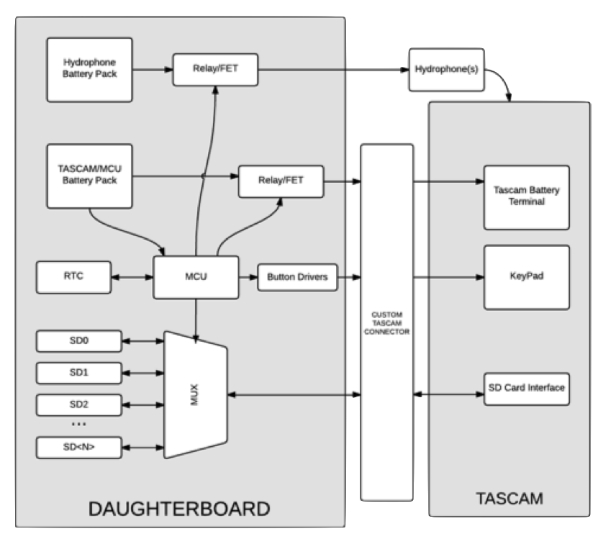
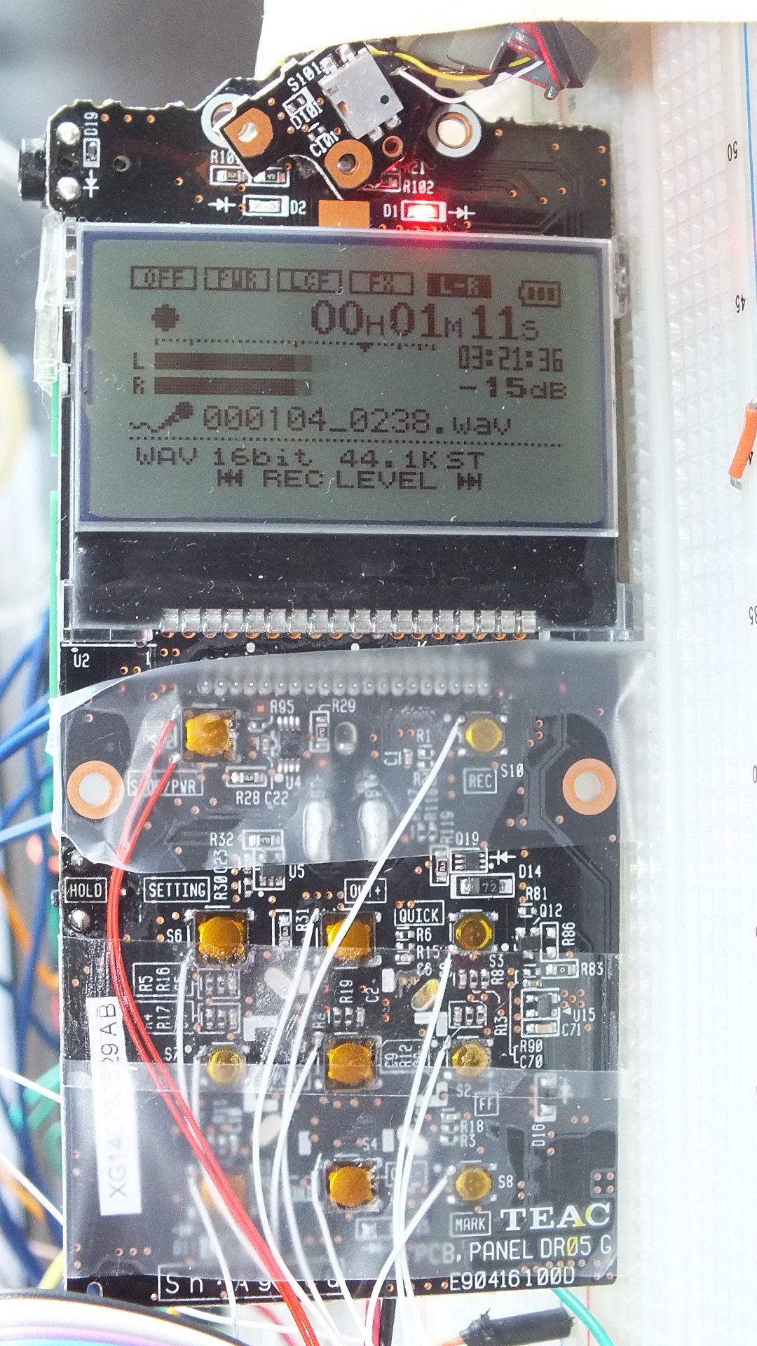
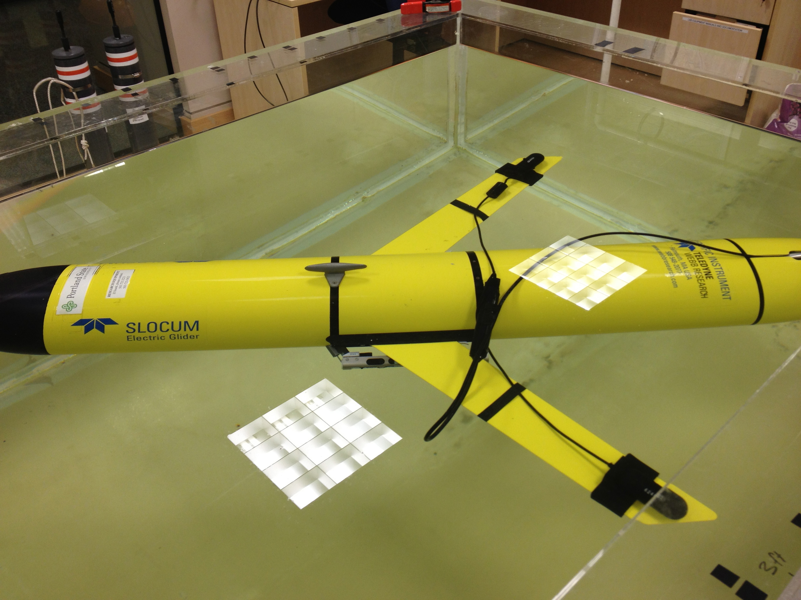
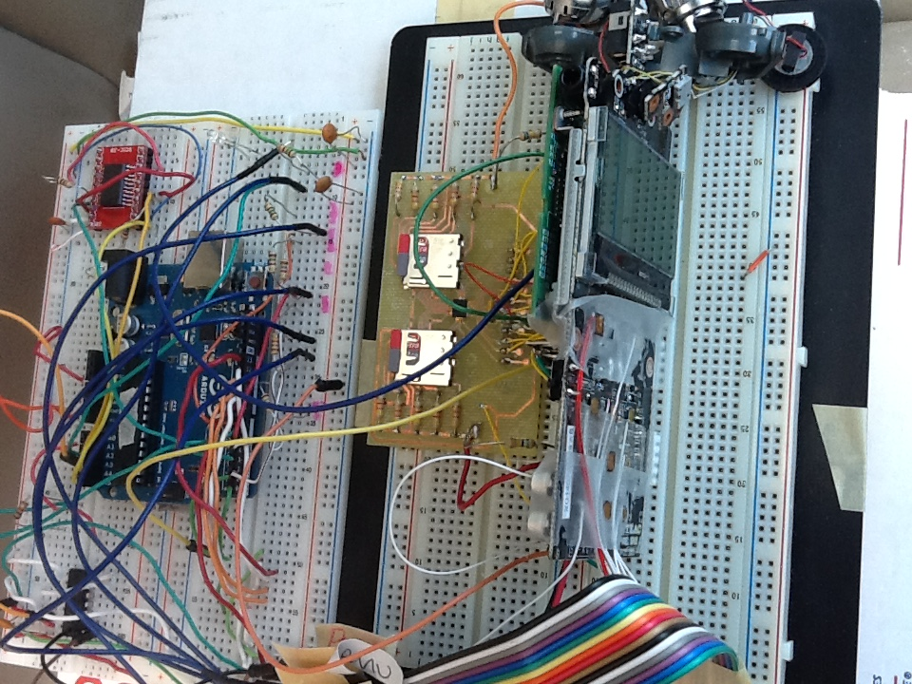
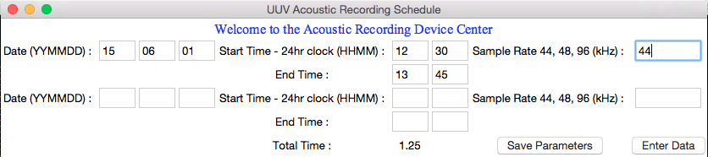



Audio Recorder for Autonomous Underwater Vehicles
Department of Electrical and Computer Engineering
Team: Chelsea Throop, Phu Nguyen, Trevor Conant, Saida Akhter
Project Problem Statement
To develop a low power 24 bit audio data acquisition system for use with a Slocum Glider and capable of recording sounds in the ocean from 0.01-50 kHz for several weeks on a programed schedule.
Goals
Design a simple, low cost micro-controller unit (MCU) for executing autonomous recording schedule and putting devices in and out of low power sleep mode
Exploit low cost (order $100) commercial analog to digigal converter (i.e., TASCAM audio recorder)
in to low power sleep mode
Develop simple graphical user interface to program
Design
Must be able to record broadband signals over 30 days,
with up to 4 days of continuous acoustic data
Must include both software and hardware update
Background
Unmanned Aerial Vehicles (sometimes referred to as UAV’s or drones) have seen widespread applications in recent years and are even being considered for package deliveries by Amazon. Underwater drones are similar in concept but do not have continuous communications so are required to mostly operate autonomously. These autonomous underwater vehicles are becoming increasingly important for applications in the ocean.
Concept
Underwater sea gliders are a specific type of underwater drone that uses a very low power buoyancy engine and is therefore acoustically quiet and can remain at sea for months at a time. This type of vehicle along with underwater microphones (hydrophones) and an acoustic recorder is ideally suited for monitoring marine life using sounds emitted by the animals. This type of marine acoustic data can be processed to estimate species, population densities and even track individual animals. This type of monitoring is an increasingly important component of environmental impact assessments required for such activities such as oil exploration.
Hardware
Data Storage
TASCAM supports microSD cards up to 32 GB
4 micro SD cards total, 128GB combined total storage to hold 4 days continuous recording
Button Interface
Must be able to turn on and off,
change sample rate, and record
without manually pressing buttons
Requires connection to
electrically end signal as if button
sequence is being pressed
Real Time Clock and MCU
PCF2127 was determined best choice for RTC chip with power consumption, temperature compensation, operating range, and I2C bus interface, communication capabilities with MCU
ATmega328p was determined best choice for MCU with on board EEPROM, I2C, low power, small sleep current, and ease of programming
Integrated Prototype
Webb Slocum Glider
Software
Pre-Mission
Allows user to program schedule record start and stop date and time and sample rate
In-Mission
RTC will awake MCU at determined schedule time. The MCU will run through the button sequence to set sample rate and begin recording
When finished recording, the Tascam will be turned off and the MCU put to sleep until next record time
Post-Mission
Removing SD card and place in laptop, list of data files are available for playback

